Slide 1
How to use this deck
Name | MBU | Red Hat Ansible Automation Best Practices
Purpose | To provide to customers and partners an best practices of using Red Hat Ansible Automation Platform in real life situations. Best practices are grouped in three parts: how to create content, how to launch automation, and how to use it in groups and larger environments. **Note: Deck does NOT contain speaker notes.
Last Updated | July 2020
What this deck is for? | Support during technical deep dives, showing best practices for real life applications.
What this deck is not for? | This is not to replace a sales or technical introduction deck.
Owner | Roland Wolters; Ansible MBU, ansible-pmm-tmm@redhat.com
List of all official Red Hat Ansible content | Red Hat Ansible Automation Platform One Stop (Red Hat Internal | Red Hat Partners)

Slide 2

Ansible Best Practices
How to write, how to execute, and how to use in real life
Notes:
Note: all images used here in the full image dividers are from pixabay.com, are thus free to use without any need for credit. The only exceptions are:
- the image from the galaxy, that is taken from Nasa.
- the three Ansible babies, taken myself.
All images carry source links in the speaker notes.

Slide 3

Create
GENERAL TIPS TO USE ANSIBLE
Notes:
The idea of this section: showing which environment Ansible best works in, how all the surroundings should be laid out, and how playbooks should be written and organized.

Slide 4
Treat your Ansible content like code
AUTOMATION IS CODE
Version control your Ansible content
Iterate
Start with a basic playbook and static inventory
Refactor and modularize later

Slide 5
Do it with style
CODE NEEDS TO HAVE STYLE GUIDELINES
Create a style guide for consistency:
Tagging
Whitespace
Naming of Tasks, Plays, Variables, and Roles
Directory Layouts
Enforce the style
Nice example: openshift-ansible Style Guide example: https://goo.gl/JfWBcW

Slide 6

CODE MUST BE ORGANIZED
USE GIT!
Notes:
Source: StockSnap, https://pixabay.com/photos/paper-puzzle-tricks-toys-games-2568647/

Slide 7
Use a clear structure
site.yml # master playbook, calling others webservers.yml # playbook for webserver tier deployonce.yml # separate playbook for single-shot tasks inventories/ production/ # different stages via inventory hosts # inventory file for production servers group_vars/ host_vars/ london/ # additional, alternative grouping if useful roles/
requirements.yml # includes roles from some other place common/ # base line, company wide configuration webtier/

Slide 8
Start with one Git repository - but when it grows, use multiple!
GIT - ONE OR MANY?
At the beginning: put everything in one Git repository
In the long term:
One Git repository per role
Dedicated repositories for completely separated teams / tasks
New to git? Get your cheat sheet here: https://opensource.com/downloads/cheat-sheet-git

Slide 9

SO, WHAT DO WE HAVE?
Notes:
Source: ninocare, https://pixabay.com/photos/books-door-entrance-culture-1655783/

Slide 10
Give inventory nodes human-meaningful names rather than IPs or DNS hostnames.
USE READABLE INVENTORY NAMES
10.1.2.75
10.1.5.45
10.1.4.5
10.1.0.40
w14301.acme.com
w17802.acme.com
w19203.acme.com
w19304.acme.com
db1 ansible_host=10.1.2.75
db2 ansible_host=10.1.5.45
db3 ansible_host=10.1.4.5
db4 ansible_host=10.1.0.40
web1 ansible_host=w14301.acme.com
web2 ansible_host=w17802.acme.com
web3 ansible_host=w19203.acme.com
web4 ansible_host=w19203.acme.com

Slide 11
Group hosts for easier inventory selection and less conditional tasks -- the more the better.
TAKE ADVANTAGE OF GROUPING
[db]
db[1:4]
[web]
web[1:4]
[east]
db1
web1
db3
web3
[west]
db2
web2
db4
web4
[dev]
db1
web1
[testing]
db3
web3
[prod]
db2
web2
db4
web4

Slide 12
Use dynamic sources where possible. Either as a single source of truth - or let Ansible unify multiple sources.
COMBINE ALL INVENTORY SOURCES
Stay in sync automatically
Reduce human error
No lag when changes occur
Let others manage the inventory

Slide 13

VARIABLES
JUST WORDS, RIGHT?
Notes:
Source: Pexels, https://pixabay.com/photos/alphabet-business-font-graffiti-1867967/

Slide 14
Proper variable names can make plays more readable and avoid variable name conflicts
DESCRIBE VARIABLES WITH THEIR NAMES
a: 25
data: ab
data2: abc
id: 123
apache_max_keepalive: 25
apache_port: 80
tomcat_port: 8080

Slide 15
Avoid collisions and confusion by adding the role name to a variable as a prefix.
PREFIX ROLE VARIABLES
apache_max_keepalive: 25
apache_port: 80
tomcat_port: 8080

Slide 16
Know where your variables are
PLACE VARIABLES APPROPRIATELY
Find the appropriate place for your variables based on what, where and when they are set or modified
Separate logic (tasks) from variables and reduce repetitive patterns
Do not use every possibility to store variables - settle to a defined scheme and as few places as possible

Slide 17

MAKE YOUR PLAYBOOK READABLE
Notes:
Source: DariuszSankowski, https://pixabay.com/photos/knowledge-book-library-glasses-1052010/

Slide 18
NO!
USE NATIVE YAML SYNTAX
- name: install telegraf
yum: name=telegraf-{{ telegraf_version }} state=present update_cache=yes enablerepo=telegraf
notify: restart telegraf
- name: start telegraf
service: name=telegraf state=started

Slide 19
Yes!
USE KEY:VALUE PAIRS
- name: install telegraf
yum:
name: “telegraf-{{ telegraf_version }}”
state: present
update_cache: yes
enablerepo: telegraf
notify: restart telegraf
- name: start telegraf
service:
name: telegraf
state: started

Slide 20
Exhibit A
DO NOT OMIT THE TASK NAME
- hosts: web
tasks:
- yum:
name: httpd
state: latest
- service:
name: httpd
state: started
enabled: yes
PLAY [web] ********************************
TASK [setup] ********************************
ok: [web1]
TASK [yum] ********************************
ok: [web1]
TASK [service] ********************************
ok: [web1]

Slide 21
Exhibit B
USE TASK NAMES
- hosts: web
name: installs and starts apache
tasks:
- name: install apache packages
yum:
name: httpd
state: latest
- name: starts apache service
service:
name: httpd
state: started
enabled: yes
PLAY [install and starts apache] ********************************
TASK [setup] ********************************
ok: [web1]
TASK [install apache packages] ********************************
ok: [web1]
TASK [starts apache service] ********************************
ok: [web1]

Slide 22

POWERFUL
BLOCKS
Notes:
Source: jeonsango, https://pixabay.com/photos/wall-damme-stone-wall-pattern-1250487/

Slide 23
Blocks can help in organizing code, but also enable rollbacks or output data for critical changes.
USE BLOCK SYNTAX
- block:
copy:
src: critical.conf
dest: /etc/critical/crit.conf
service:
name: critical
state: restarted
rescue:
command: shutdown -h now

Slide 24

Run
EXECUTING THE ANSIBLE COMMANDS
Notes:
The idea of this section: when executing Ansible commands, there are some tricks that can help, especially when things do not work the way they should.

Slide 25

PROPER LAUNCHING
Notes:
Source: SpaceX-Imagery, https://pixabay.com/photos/rocket-launch-night-trajectory-693200/

Slide 26
Don’t just start services -- use smoke tests
CHECK IMMEDIATELY WHAT WAS DONE
- name: check for proper response
uri:
url: http://localhost/myapp
return_content: yes
register: result
until: '"Hello World" in result.content'
retries: 10
delay: 1

Slide 27
Ansible provides multiple switches for command line interaction and troubleshooting.
TROUBLESHOOT ON EXECUTION
-vvvv
--step
--check
--diff
--start-at-task

Slide 28
Ansible has switches to show you what will be done
ANALYZE WHAT YOUR ARE RUNNING
Use the power of included options:
--list-tasks
--list-tags
--list-hosts
--syntax-check

Slide 29
If there is a need to launch something without an inventory - just do it!
QUICKLY LAUNCH WITHOUT INVENTORY
For single tasks - note the comma:
ansible all -i neon.qxyz.de, -m service -a "name=redhat state=present"
For playbooks - again, note the comma: ansible-playbook -i neon.qxyz.de, site.yml

Slide 30

THE RIGHT TOOLS
Notes:
Source: stevepb, https://pixabay.com/photos/confused-muddled-illogical-880735/

Slide 31
Try to avoid the command module - always seek out a module first
USE NATIVE MODULES WHERE POSSIBLE
- name: add user
command: useradd appuser
- name: install apache
command: yum install httpd
- name: start apache
shell: |
service httpd start && chkconfig httpd on
- name: add user
user:
name: appuser
state: present
- name: install apache
yum:
name: httpd
state: latest
- name: start apache
service:
name: httpd
state: started
enabled: yes

Slide 32
If managed files are not marked, they might be overwritten accidentally
MARK MANAGED FILES
Label template output files as being generated by Ansible
Use the ansible_managed** variable with the comment filter
{{ ansible_managed | comment }}

Slide 33

COLLECTIONS AND GALAXIES
Notes:
Source: Nasa, https://www.nasa.gov/multimedia/imagegallery/image_feature_283.html

Slide 34
Roles enable you to encapsulate your operations.
USE ROLES WHERE POSSIBLE
Like playbooks -- keep roles purpose and function focused
Store roles each in a dedicated Git repository
Include roles via roles/requirements.yml file, import via ansible-galaxy tool
Limit role dependencies

Slide 35
Get collections from Galaxy, but be careful and adopt them to your needs
USE GALAXY - WITH CARE
Collections can contain roles, and other other code like modules as well
Galaxy provides thousands of roles and collections
Quality varies drastically
Take them with a grain of salt
Pick trusted or well known authors

Slide 36

ACCESS RIGHTS
Notes:
Source: TheDIgitalWay, https://pixabay.com/photos/data-security-keyboard-computer-1590455/

Slide 37
Root access is harder to track than sudo - use sudo wherever possible
USE BECOME, DON’T BE A ROOT
Don’t run as root
But login and security reasons often request non-root access
Use become method - so Ansible scripts are executed via sudo (sudo is easy to track)
Best: create an Ansible only user
Don’t try to limit sudo rights to certain commands - Ansible does not work that way!

Slide 38

DEBUG YOUR PROBLEM
Notes:
Source: hoffmann-tipsntrips, https://pixabay.com/photos/bobby-car-unfall-gefahr-spielzeug-2426781/

Slide 39
Check logging on target machine
HAVE A LOOK AT THE NODE LEVEL
ansible-node sshd[2395]: pam_unix(sshd:session): session
opened for user bob by (uid=0)
ansible-node ansible-yum[2399]: Invoked with name=['httpd']
list=None install_repoquery=True conf_file=None
disable_gpg_check=False state=absent disablerepo=None
update_cache=False enablerepo=None exclude=None

Slide 40
How to keep the code executed on the target machine
IN WORST CASE, DEBUG ACTUAL CODE
Look into the logging of your target machine
$ ANSIBLE_KEEP_REMOTE_FILES=1 ansible target-node -m yum
-a "name=httpd state=absent"
Execute with:
$ /bin/sh -c 'sudo -u $SUDO_USER /bin/sh -c
"/usr/bin/python /home/bob/.ansible/tmp/..."

Slide 41
Debugging tasks can clutter the output, apply some housekeeping
USE THE DEBUG MODULE
- name: Output debug message
debug:
msg: "This always displays"
- name: Output debug message
debug:
msg: "This only displays with ansible-playbook -vv+"
verbosity: 2

Slide 42

Scale
GET TOWER TO ADOPT ANSIBLE IN YOUR DATA CENTER
Notes:
Source: Red Hat corporate image set
The idea of this section: showing how Tower helps using Ansible in more complex, enterprise environments.

Slide 43
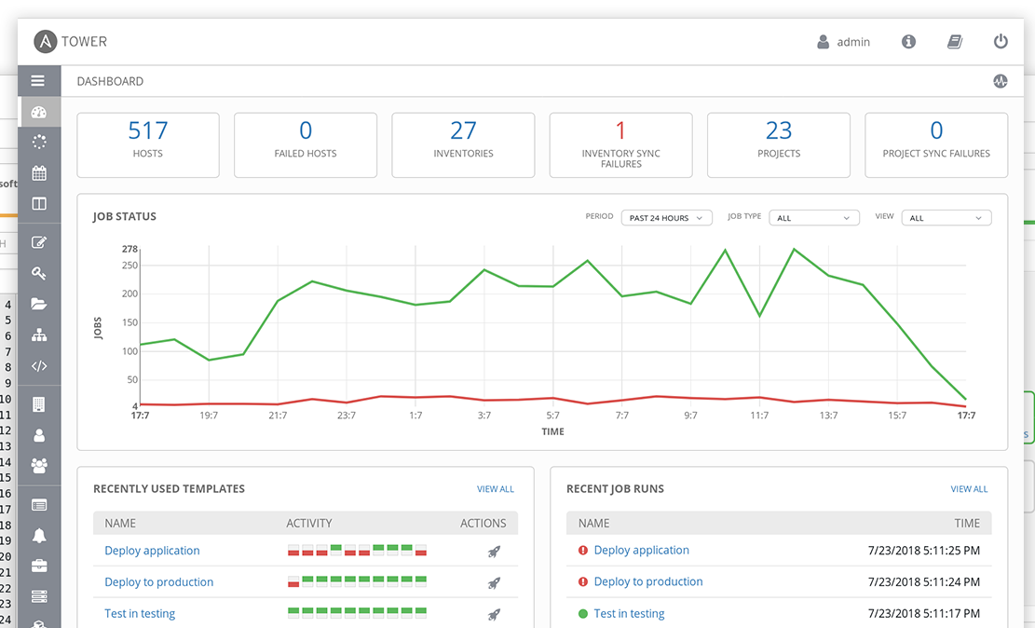
Simple: Use Tower.
TOWER FUNCTIONS
Tower was developed with Ansible in mind
Extends the limits of Ansible to meet enterprise needs:
Scalability, API, RBAC, audits, etc.

Slide 44
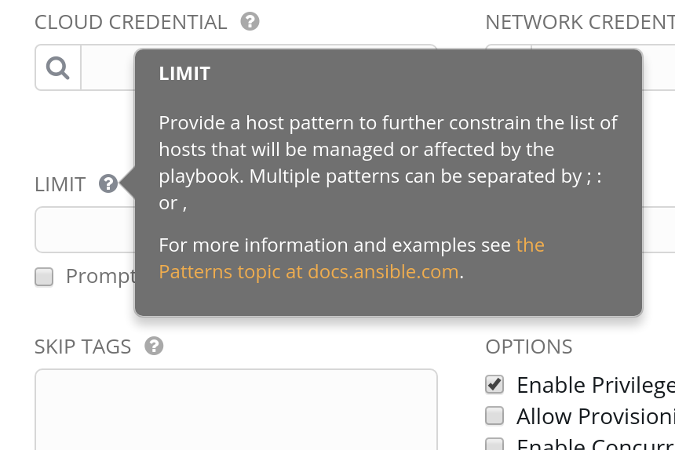

Tower has inbuilt help
TOWER FUNCTIONS
Tower provides in-program help via questionmark bubbles
Can include examples or links to further docs

Slide 45

BRANCHES, ANYONE?
Notes:
Source: DarkWorkX, https://pixabay.com/photos/trees-road-northern-ireland-3464777/

Slide 46
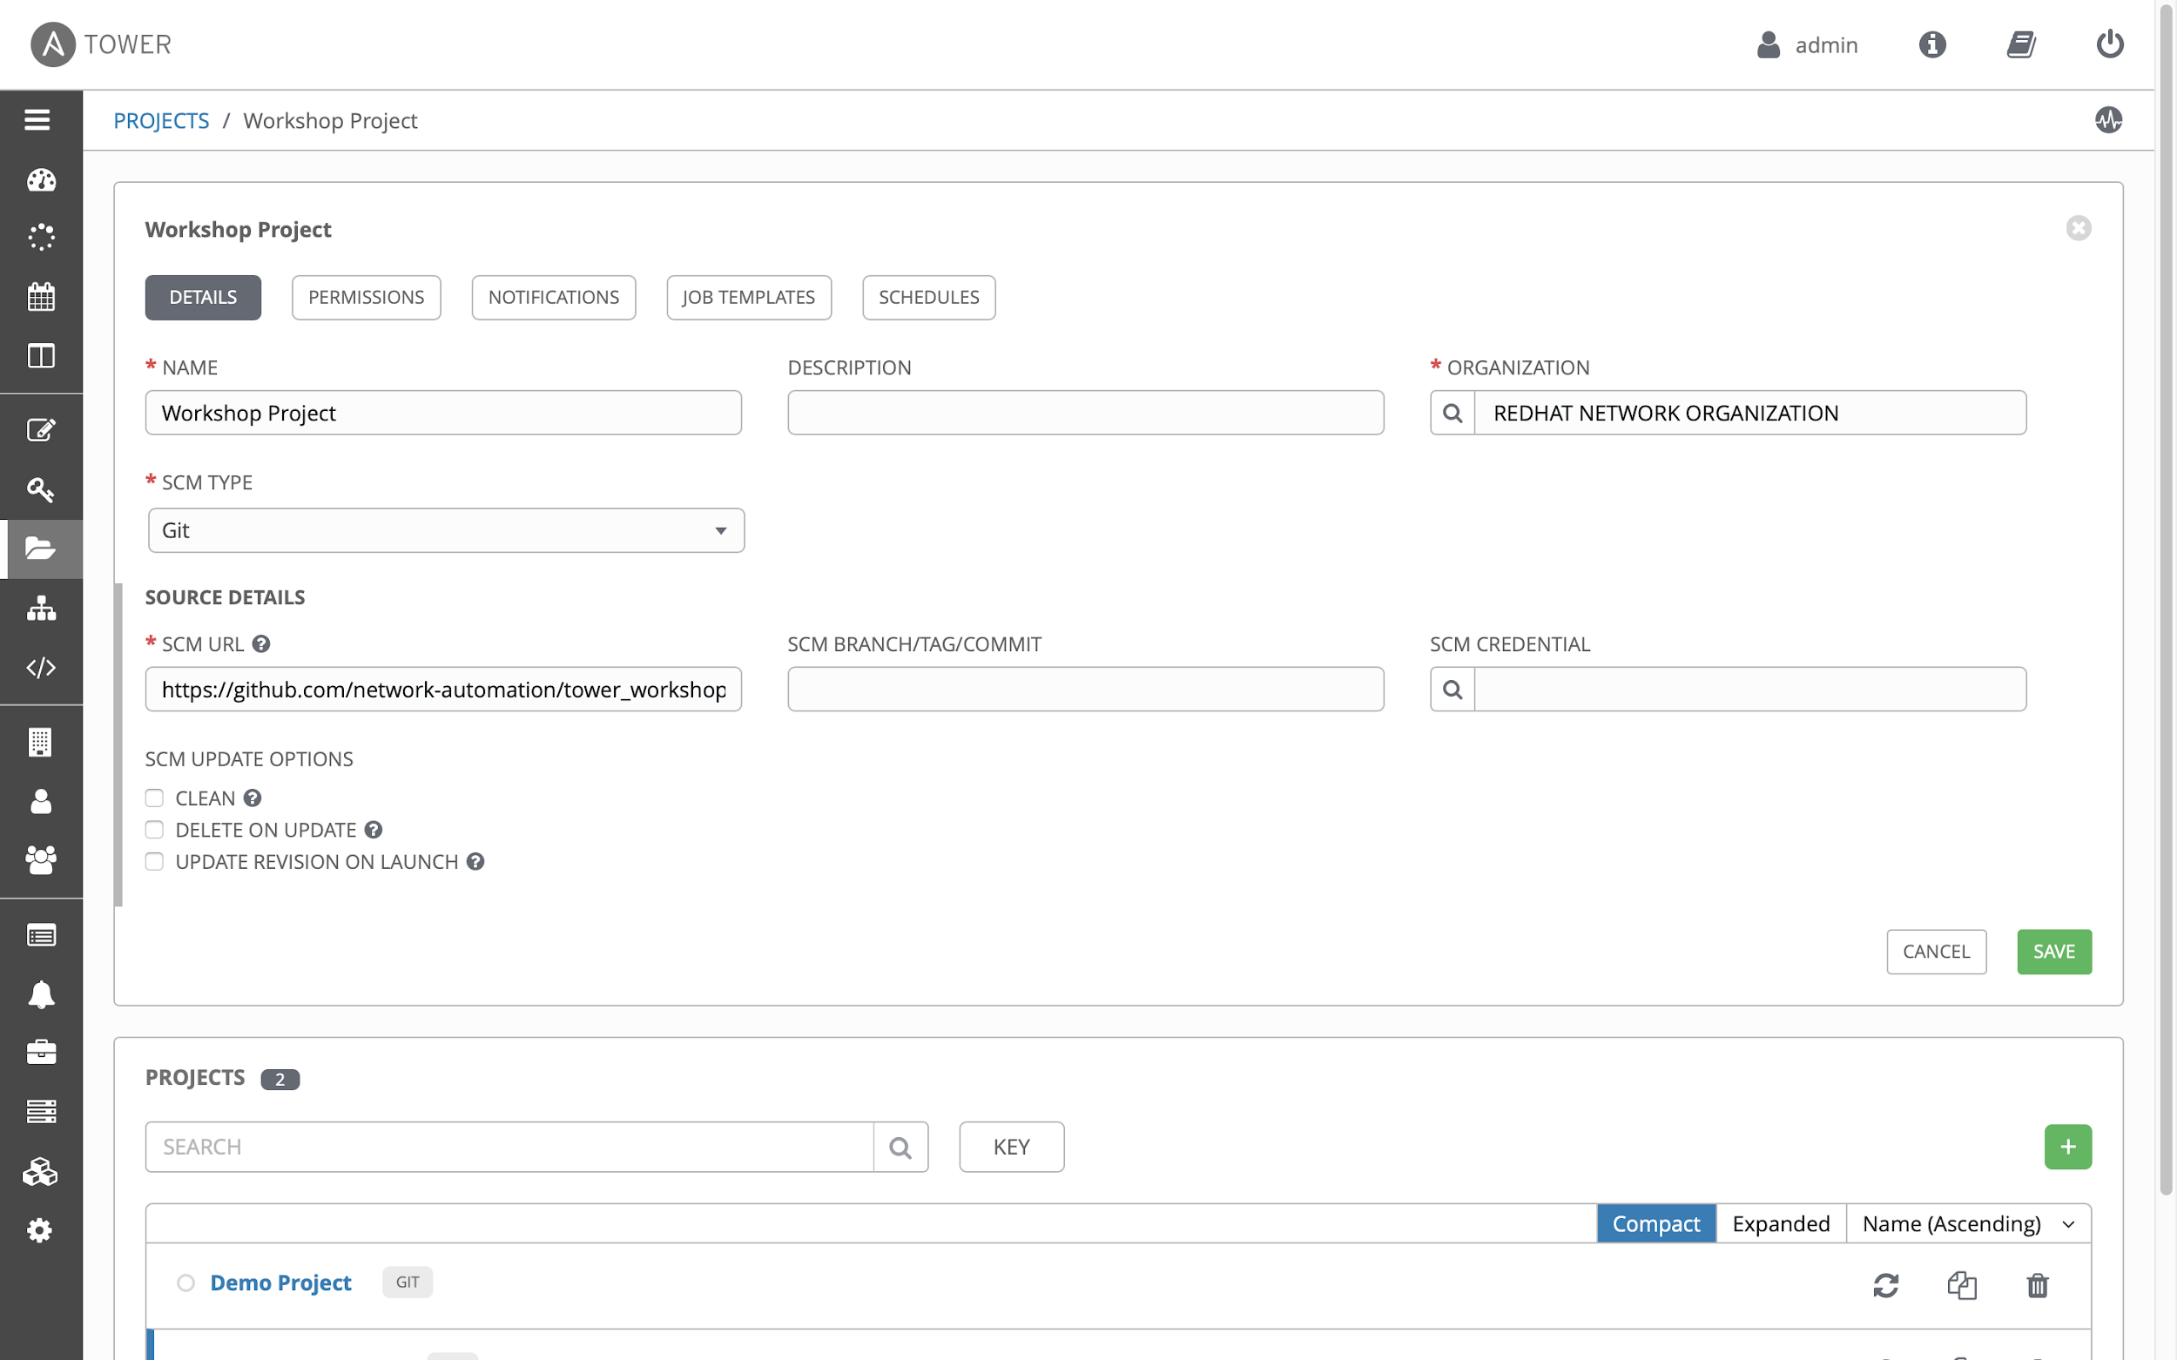
Tower can import a repository multiple times with different branches
TAKE ADVANTAGE OF GIT BRANCHES
Use feature or staging branches in your Git
Import them all separately, address them separately
Useful for testing of new features but also to move changes through stages

Slide 47

MANY, MANY ROLES
Notes:
Source: Bru-nO, https://pixabay.com/photos/yarn-thread-sew-thread-spool-1615524/

Slide 48
Tower automatically imports Roles during Project update
TOWER & ROLES
Do not copy roles into your playbook repository, just create a roles/requirements.yml
Tower will automatically import the roles during Project installation
Mix roles from various sources
Fix version in roles/requirements.yml to have auditable environment!

Slide 49

WHAT ARE WE TALKING TO?
Notes:
Source: jackmac34, https://pixabay.com/photos/diary-appointment-address-pen-2080422/

Slide 50
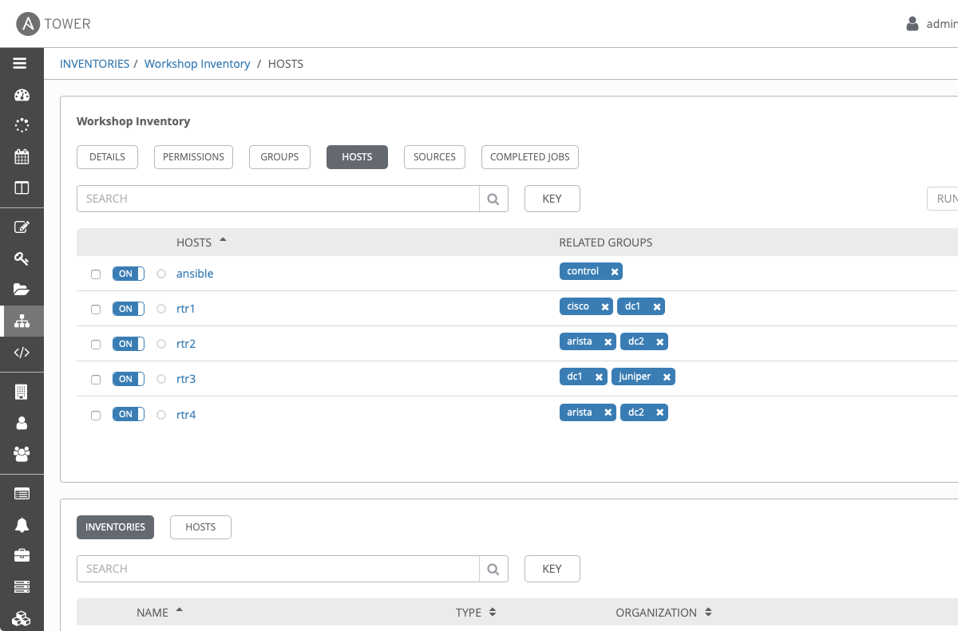
Use dynamic & smart inventories
TOWER FUNCTIONS
Combine multiple inventory types
Let Tower take care of syncing and caching
Use smart inventories to group nodes

Slide 51

DOING GOOD JOBS
Notes:
Source: Tumisu, https://pixabay.com/photos/team-work-building-office-4200837/

Slide 52
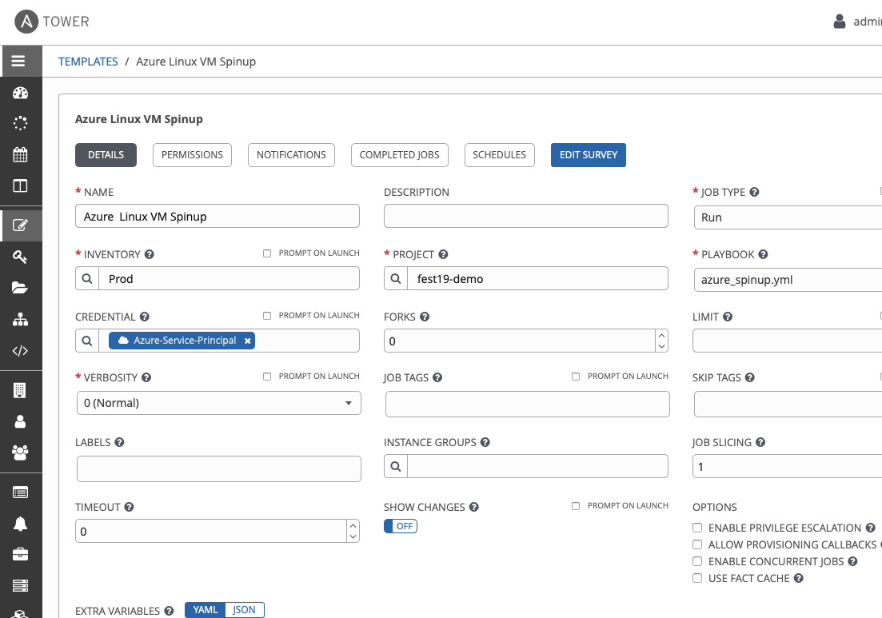
Tower job templates provide multiple options - use them wisely
USE THE POWER OF JOB TEMPLATES
Keep jobs simple, focussed - as playbooks or roles
Add labels to them to better filter
For idempotent jobs, create “check” templates as well - and let them run over night
Combine with notifications - and get feedback when a “check” failed

Slide 53

1+1+1 = 1
Notes:
Source: geralt, https://pixabay.com/photos/organization-organization-chart-2478211/

Slide 54
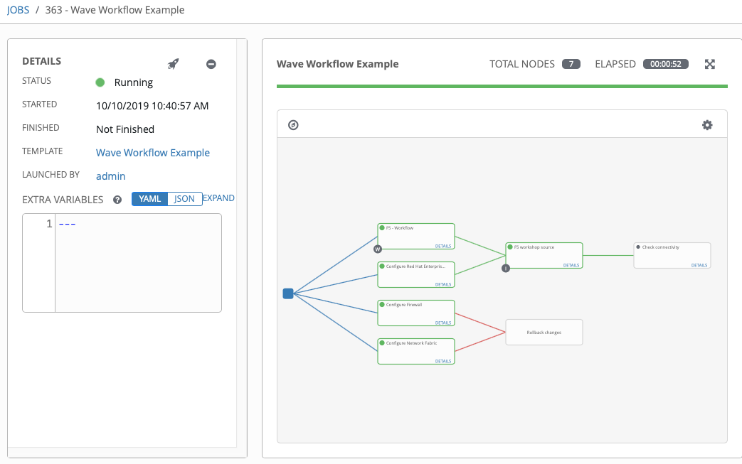
Multiple playbooks can be combined into one workflow
USE WORKFLOWS FOR COMPLEX TASKS
Simple jobs, complex workflows
React to problems via workflow
Combine playbooks of different teams, different repositories
Re-sync inventories during the play

Slide 55

DO ASK PROPER QUESTIONS
Notes:
Source: geralt, https://pixabay.com/photos/questions-board-blackboard-font-2212771/

Slide 56
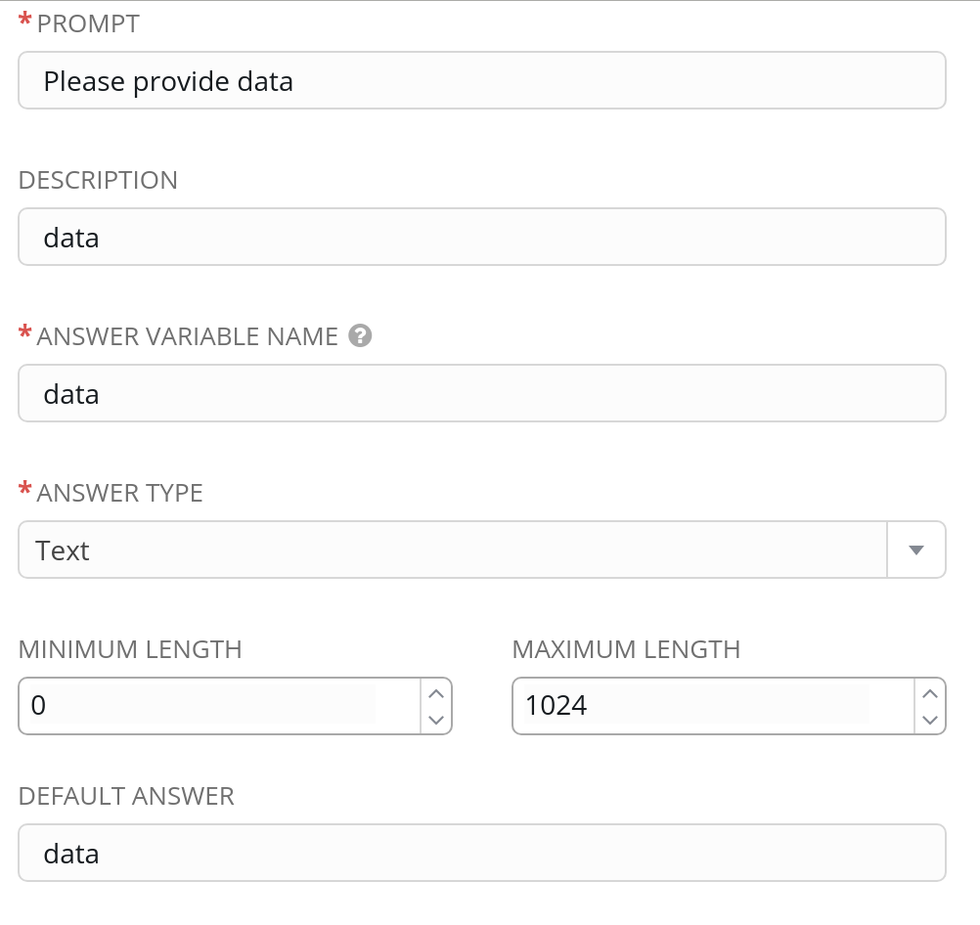
Use surveys to get variable values
TOWER FUNCTIONS
Use good, meaningful variable names
Provide a default choice
Multiple choice > free text
If answer not required - do you really need it at all?
QUICK TIP
Try right clicking on the icon and using “Replace Image” to insert your own icons.

Slide 57

A POWERFUL TEAM
Notes:
Source: Roland Wolters (myself)

Slide 58
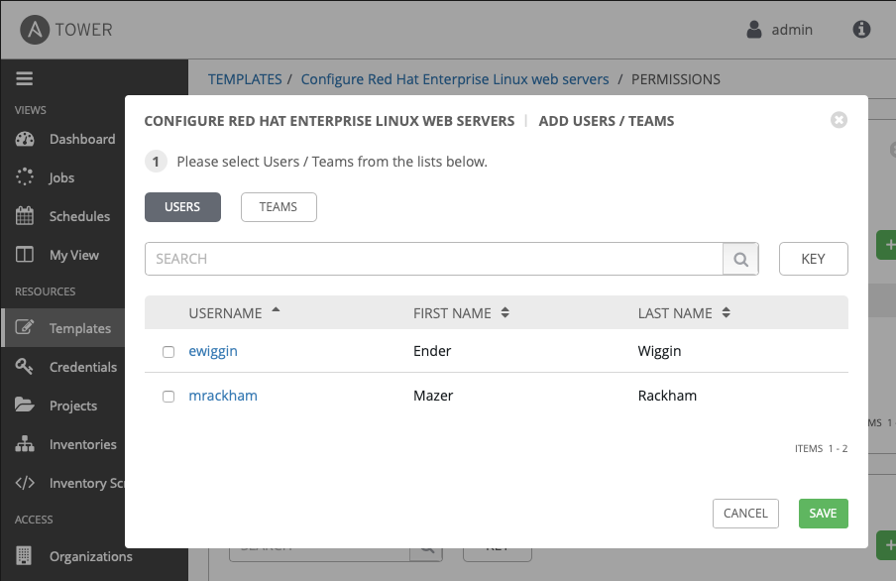
Tower provides tenants, teams, and users - use them for separation
USE TOWER TEAMS, SEPARATIONS
Provide automation to others without exposing credentials
Let others only see what they really need
Use personal view instead of full Tower interface

Slide 59

ONE KEY TO RULE THEM ALL ...
Notes:
Spurce: StockSnap, https://pixabay.com/photos/lock-keys-black-and-white-steel-2597135/

Slide 60
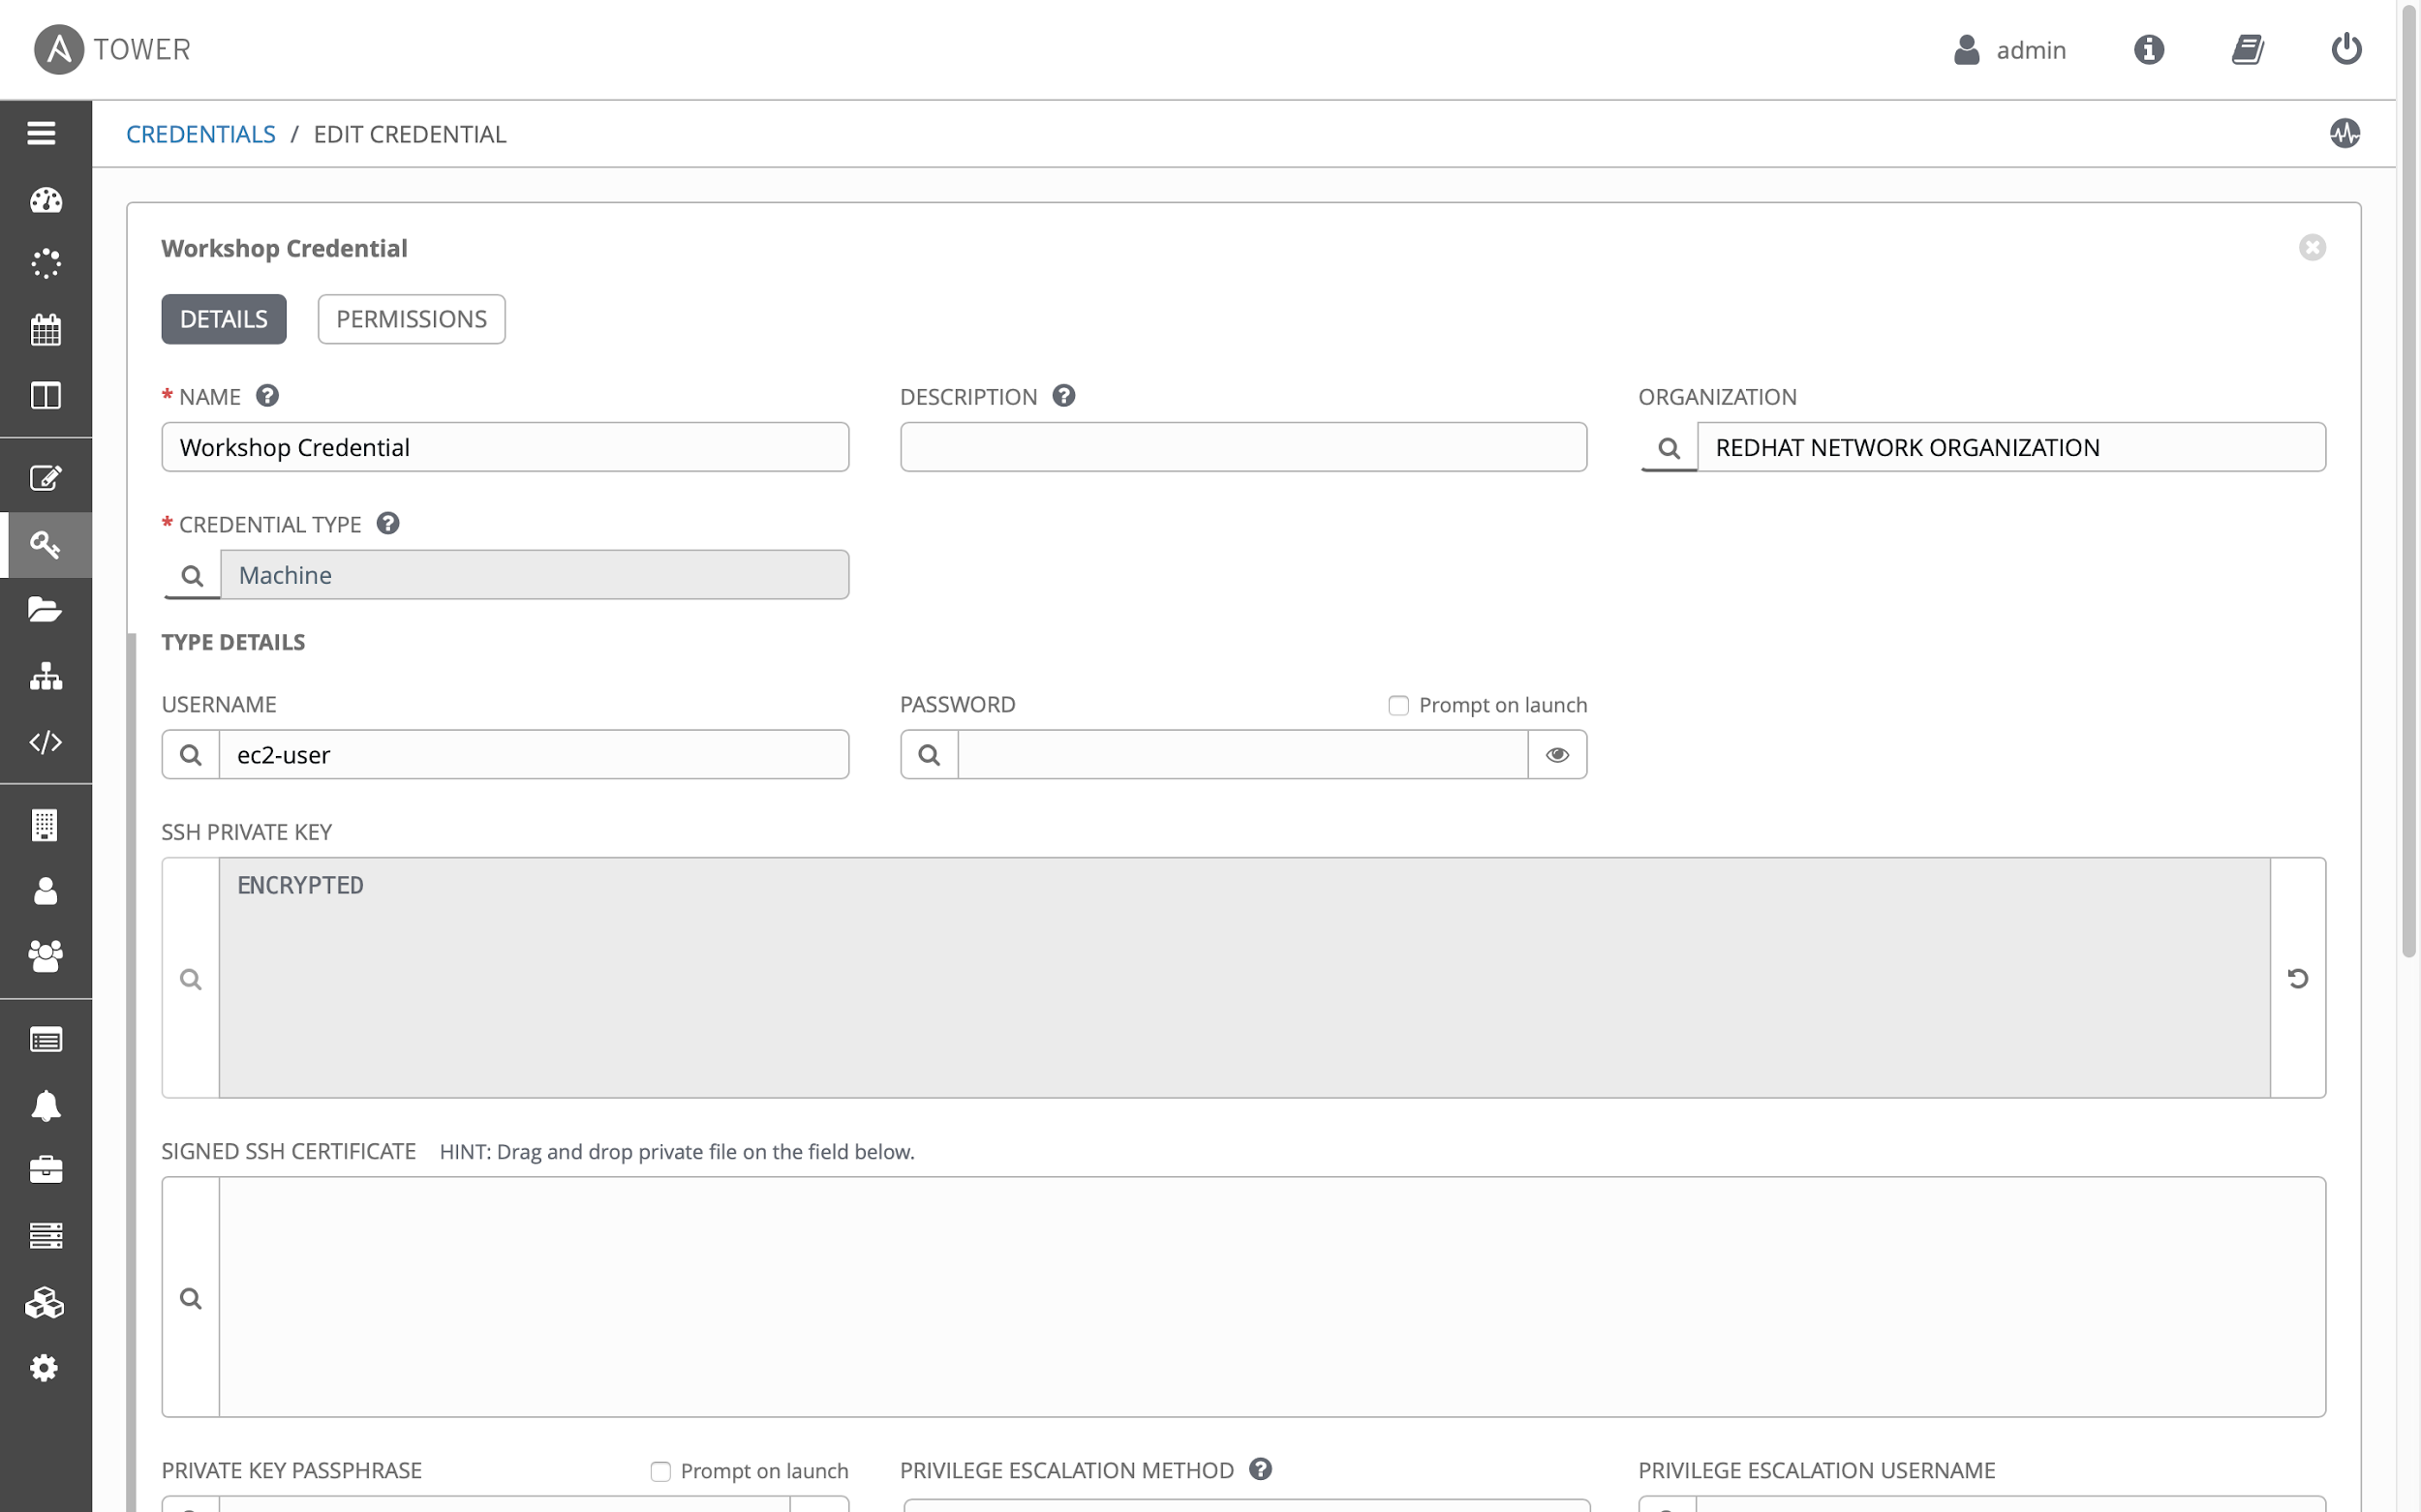
Tower credentials should only be used by Tower - not by others
USE TOWER SPECIFIC ACCESS CREDENTIALS
Set up a separate user and password/key for Tower
That way, automation can easily be identified on target machines
The key/password can be ridiculously complicated secure
Store key/password in a safe for emergencies

Slide 61

NOTIFY YOURSELF!
Notes:
Source, Capri23auto, https://pixabay.com/photos/mailbox-letter-boxes-post-mail-box-2438215/

Slide 62
Tower can send notifications if a job succeeds, fails or always - as mail, IRC, web hook, and so on
LET TOWER SEND NOTIFICATIONS TO YOU
Let Tower notify you and your team if something breaks
Send mails/web-hooks automatically to a ticket systems and monitoring if there is a serious problem

Slide 63

LOGS, ANYONE?
Notes:
Source: Pexels, https://pixabay.com/photos/batch-dry-firewood-forestry-logs-1868104/

Slide 64
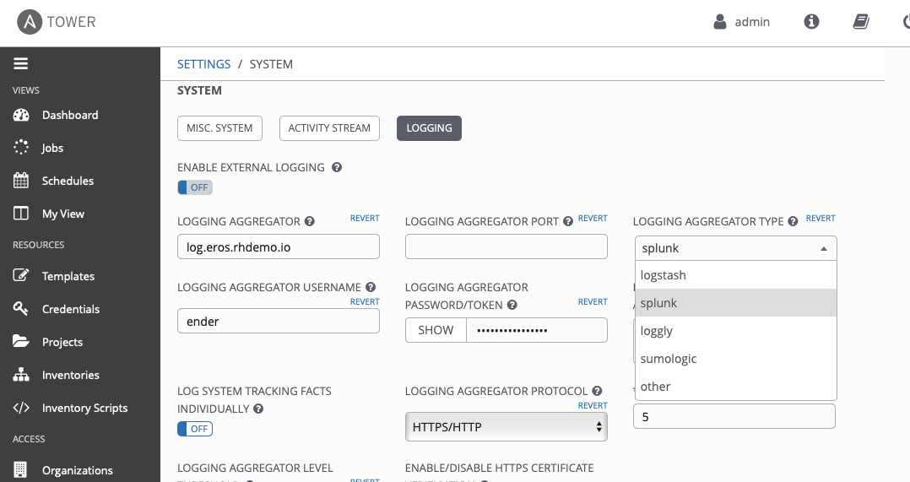
Send all logs from Tower to central logging
CONNECT TOWER TO CENTRAL LOGGING
Splunk, Loggly, ELK, REST
Send results from Ansible runs - but also from Tower changes

Slide 65

ALWAYS KEEP THE LIGHTS ON
Notes:
Source: Bru-nO, https://pixabay.com/photos/lamp-light-lighting-light-bulb-3489395/

Slide 66

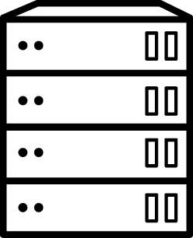

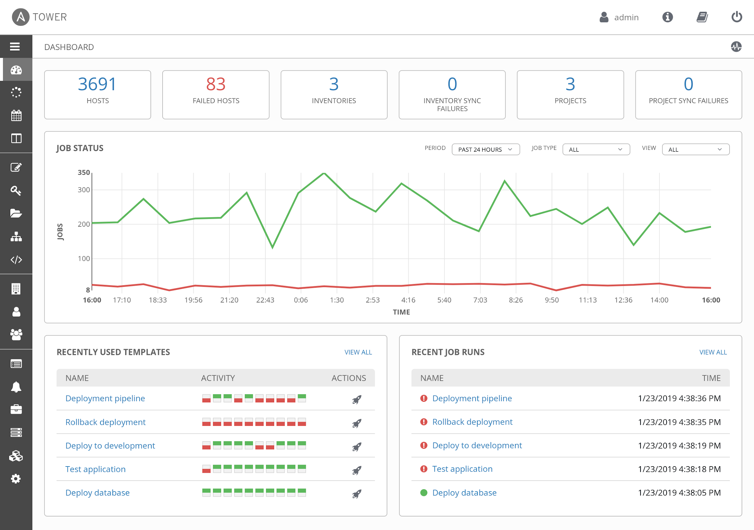
Tower can be easily set up HA - and for restricted networks, deploy isolated nodes
USE HA, DEPLOY ISOLATED NODES
Make Tower HA - it is easy! (Well, except the DB part maybe….)
For distant or restricted networks, use isolated nodes

Slide 67
Thank you
Red Hat is the world’s leading provider of enterprise open source software solutions. Award-winning support, training, and consulting services make Red Hat a trusted adviser to the Fortune 500.

